Slide 1

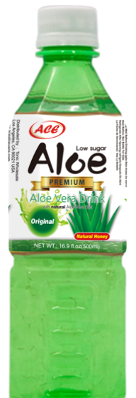
Discover ACE Aloe
A refreshing aloe-based beverage created for hydration, wellness, and everyday balance.
Refresh. Hydrate. Restore.
Tonic & Lee | ACE Aloe
01

Slide 2

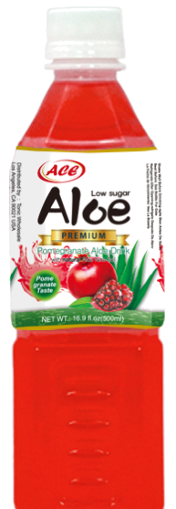
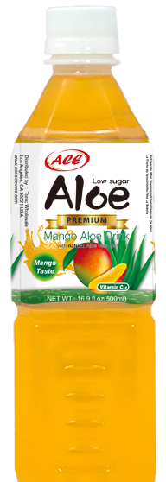
ACE Aloe Product Presentation
Brand Overview | Product Benefits | Market Opportunity
Presented by Tonic & Lee’s
A clean, retail-ready aloe beverage designed for today’s health-conscious consumer.
Refresh. Hydrate. Restore.
Tonic & Lee | ACE Aloe
02

Slide 3
ACE Aloe
Natural Wellness. Everyday Refreshment.
Aloe, the way it was meant to taste.
Low-sugar aloe drink built on real aloe vera gel. Three flavors. Two sizes. One short ingredient list.
77
500ml
3
cal / serving
flavors
Made in Korea | Distributed in North America by Tonic & Lee
Tonic & Lee | ACE Aloe
03

Slide 4
Built for clean refreshment.
ACE is a low-sugar aloe drink with real aloe gel and simple, visible ingredients.
Real aloe gel
Key product facts
Visible aloe vera gel pieces in every bottle. No aloe powder shortcuts.
Original — 77 cal per 240ml serving
• Pack 500ml × 20
• Pack 1.5L × 12
• Origin: Busan, KR
Low sugar profile
Sweetened with natural honey and stevia to keep every sip light.
Retail friendly
Available in 500ml and 1.5L bottles for immediate consumption and take home.
Tonic & Lee | ACE Aloe
04

Slide 5
A short ingredient list, on purpose.
No high-fructose syrups. No aloe powder shortcuts. The ingredients on the label are doing the work.
Natural Honey
Stevia
Real honey for clean, mellow sweetness — never refined or corn-syrup-based.
A natural, plant-based sweetener that keeps every serving low in sugar.
8% Real Aloe Gel
Hydrates from the inside out.
Whole aloe vera gel with visible pieces in every bottle. No aloe powder.
Aloe Vera contains over 75 active components, including a broad range of vitamins that
functions as antioxidants which also promotes skin and hair health.
Tonic & Lee | ACE Aloe
05

Slide 6
Three flavors. Real aloe gel in bottle.
Each flavor keeps the aloe gel texture and low-sugar positioning while giving shoppers a clear choice.
Original
77 cal • 500ml
Pomegranate
71 cal • 500ml
Mango
71 cal • 500ml
Clean, faintly sweet, with bite-sized aloe gel pieces.
Tart, ruby, and surprisingly dry. Aloe gel keeps it grounded.
Ripe Alphonso character, with vitamin C and the same low-sugar profile.
Tonic & Lee | ACE Aloe
06

Slide 7
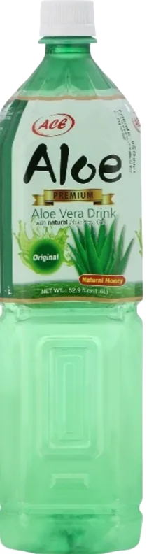
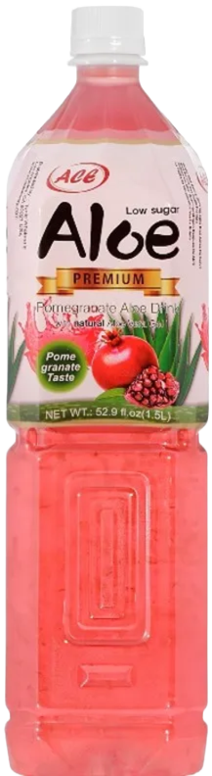
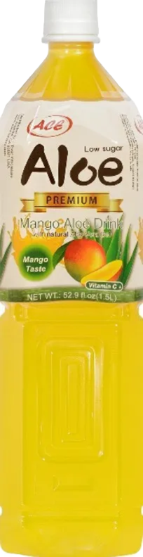
Three flavors. Real aloe gel in bottle.
Each flavor keeps the aloe gel texture and low-sugar positioning while giving shoppers a clear choice.
Original
231 cal • 1.5L
Pomegranate
213 cal • 1.5L
Mango
213 cal • 1.5L
Clean, faintly sweet, with bite-sized aloe gel pieces.
Tart, ruby, and surprisingly dry. Aloe gel keeps it grounded.
Ripe Alphonso character, with vitamin C and the same low-sugar profile.
Tonic & Lee | ACE Aloe
07

Slide 8
Thank You
ACE Aloe
richlaitinen@tonicnlees.com
661-674-5756

